Slide 1

WIPRO NGA Program – 25SUB4530_CP_JAVA
Capstone Project Presentation – 9th Feb & 10th Feb 2026
Project Title Here – Employee Management System
Presented by – Niranchana Jayesh
Poorneswar Reddy
www.rpsconsulting.in

Slide 2
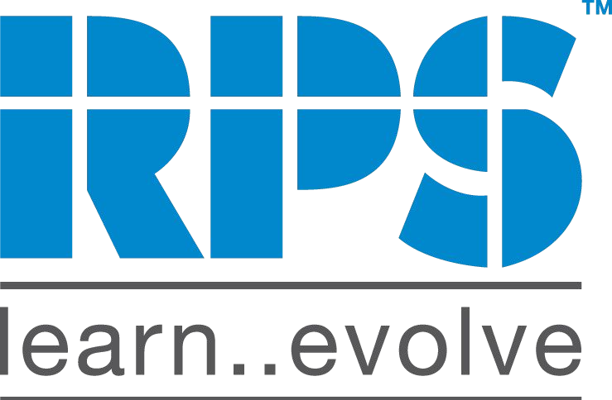
Employee Management System
Introduction
The Employee Management System is a modern web-based solution developed to simplify the process of managing employee information within an organization. It enables administrators to store, update, retrieve, and manage employee records efficiently through a centralized digital platform.
The system eliminates manual paperwork and reduces data handling errors by providing a structured database and automated operations. With an interactive user interface and secure backend processing, the application ensures quick access to employee data and smooth record management.
This solution improves administrative productivity, enhances data accuracy, and provides organizations with an effective tool for employee information management.

Slide 3
Employee Management System
Project Overview
The Employee Management System is a web-based application developed to manage employee information in an efficient and organized manner. It provides a centralized platform where administrators can easily add, update, search, view, and delete employee records.
The system integrates a responsive Angular frontend with a Spring Boot backend that handles business logic and database operations through RESTful APIs. By automating employee record management, the application reduces manual work, improves data accuracy, and ensures quick access to employee information.
Overall, the project aims to simplify employee data management and enhance operational efficiency within organizations.

Slide 4
Employee Management System
Problem Statement
In many organizations, employee records are still managed manually or through multiple disconnected systems. This often leads to errors, duplicated data, and difficulties in maintaining accurate information. Finding or updating employee details can become slow and confusing, especially when the number of employees increases.
To overcome these challenges, there is a need for a centralized and automated system that can efficiently manage employee information. An Employee Management System helps reduce manual effort, improves data accuracy, and makes employee record management faster and more reliable.

Slide 5
Employee Management System
Key Objectives
To maintain employee records in a centralized and organized system.
To reduce errors caused by manual data handling.
To provide quick access for searching and updating employee information.
To improve efficiency in managing employee data.
To simplify administrative operations related to employee management

Slide 6
Employee Management System
Technology Stack
Frontend Technologies
  Angular framework used to build a responsive and interactive user interface.
  HTML, CSS, and TypeScript used for UI structure and styling.
Backend Technologies
  Spring Boot used to implement business logic and REST APIs.
  Spring Data JPA used for database interaction and Object Relational Mapping functionality.
Database
  MySQL is used to store employee records securely.
DevOps & Deployment
  Docker used for containerization of the application.
  Microsoft Azure App Service used for cloud deployment and scalability.

Slide 7
Employee Management System
Core Functionalities
Add new employee records into the system.
Update existing employee information when required.
Delete employee records from the database.
View employee details in an organized format.
Search employees by name or department.
Validate user input to ensure accurate data entry.
❖
2024 - RPS Consulting all rights reserved
8
General - RPS
Data

Slide 8
Employee Management System Frontend Design
The frontend is developed using Angular to provide a responsive and interactive user interface.
User-friendly forms are implemented for adding and updating employee details.
Employee records are displayed using structured data tables for easy viewing.
Input validation is applied to ensure correct data entry.
Navigation components enable smooth access to different modules of the application.

Slide 9
Employee Management System Backend Design
The backend is developed using Spring Boot to handle application logic and request processing.
❖ RESTful APIs are created to enable communication between frontend and backend.
❖ Business logic is implemented to process employee data operations.
❖ Spring Data JPA is used for efficient interaction with the database.
❖ Exception handling mechanisms ensure stable and reliable system performance.

Slide 10
Employee Management System Database Design
Employee information is stored in a relational database in a structured format.
❖ Tables are designed to maintain employee details such as ID, name, department, and salary.
❖ Database supports efficient CRUD operations for managing employee records.
❖ Spring Data JPA is used to simplify database interaction and data mapping.
❖ Proper data organization ensures consistency, integrity, and secure storage of records.

Slide 11
Employee Management System Project Overview
The Employee Management System is a web-based application developed to manage employee records efficiently.
It provides a centralized platform for storing and maintaining employee information.
Administrators can add, update, view, search, and delete employee records easily.
The system integrates an Angular frontend with a Spring Boot backend using RESTful APIs.
Employee data is securely stored in a relational database for efficient access.
The application is containerized using Docker for easy deployment and portability.
The system is deployed on Microsoft Azure, ensuring scalability and reliable cloud access

Slide 12
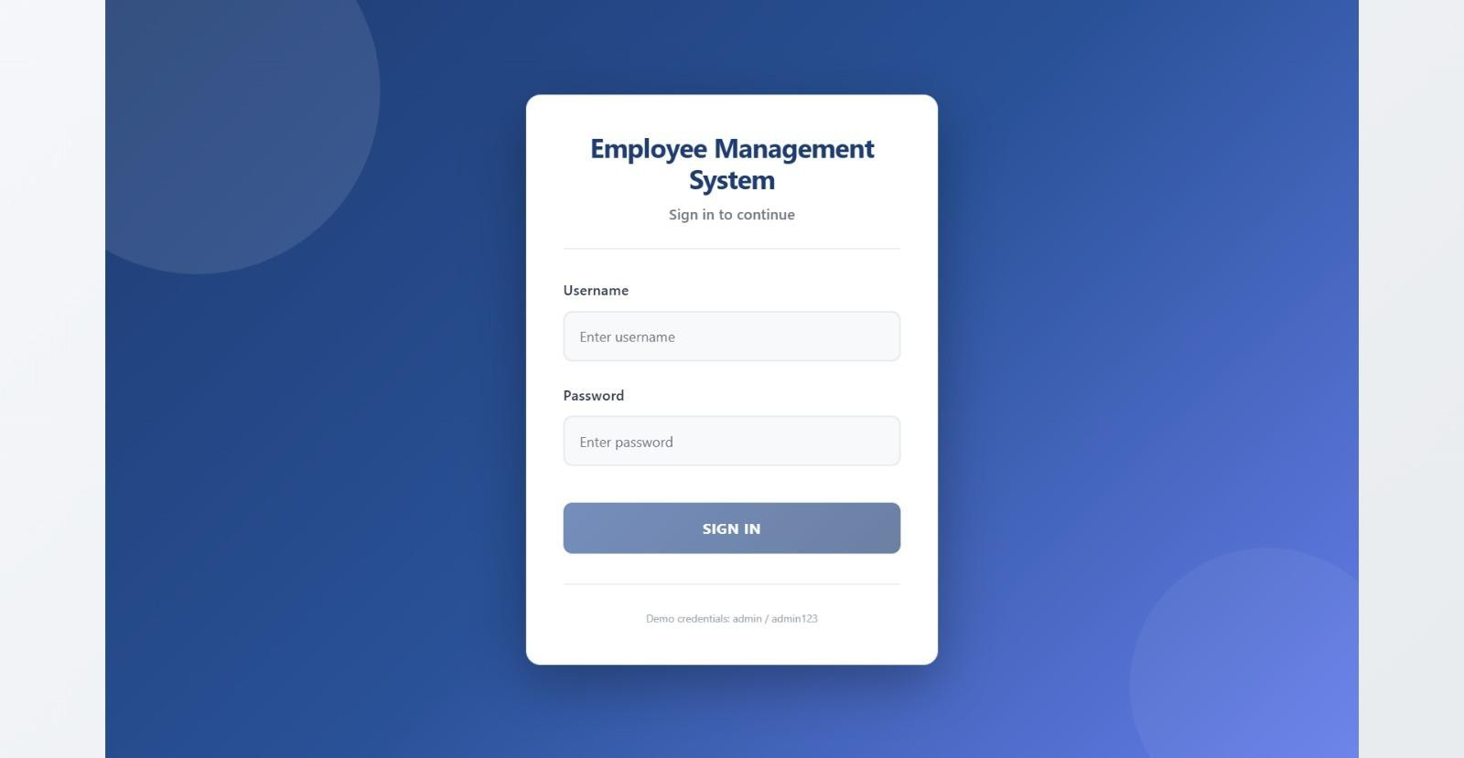
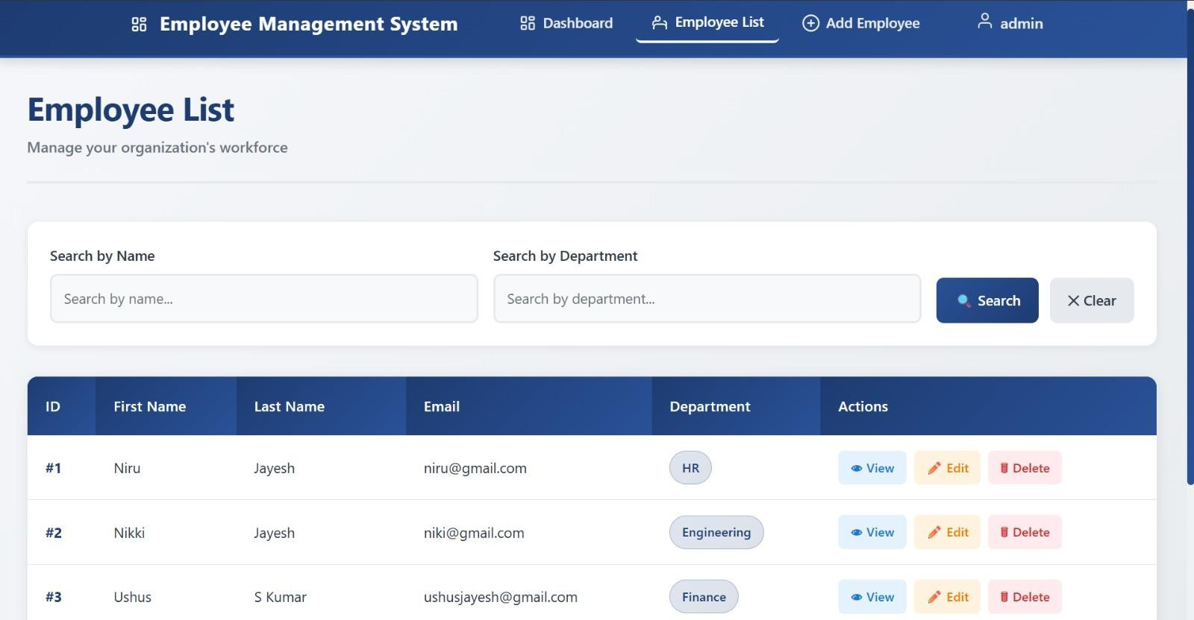
Employee Management System Application ScreenShots
Login Page
Employee List - Page

Slide 13
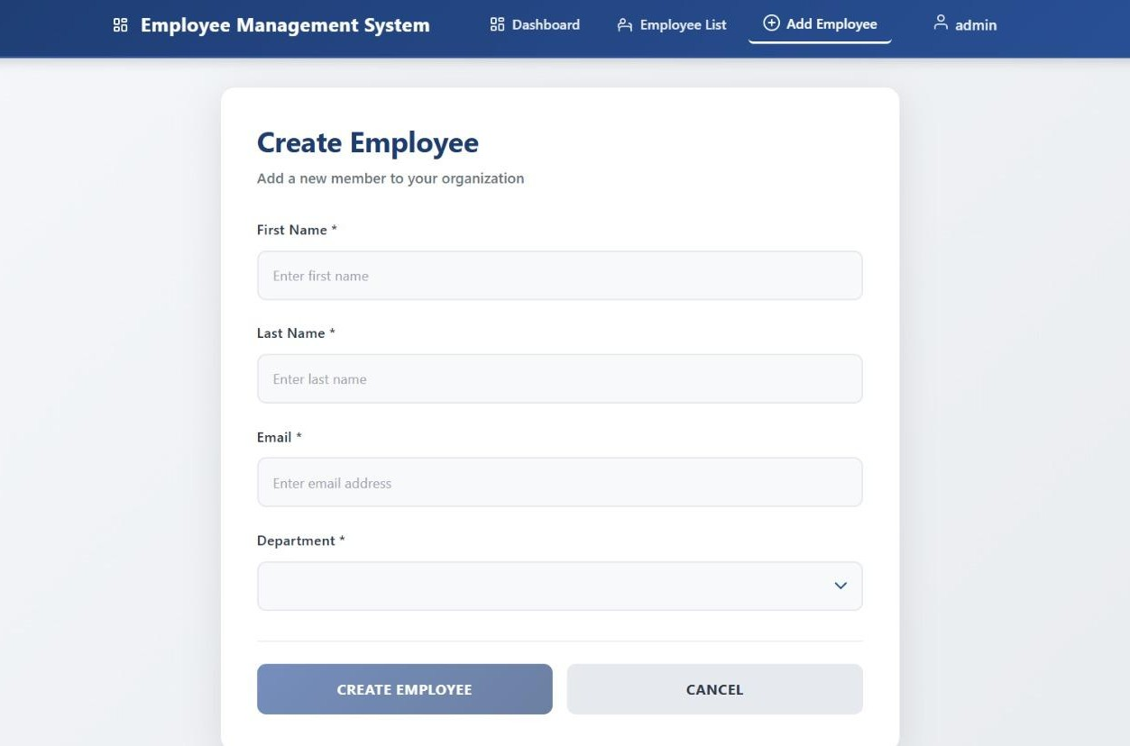
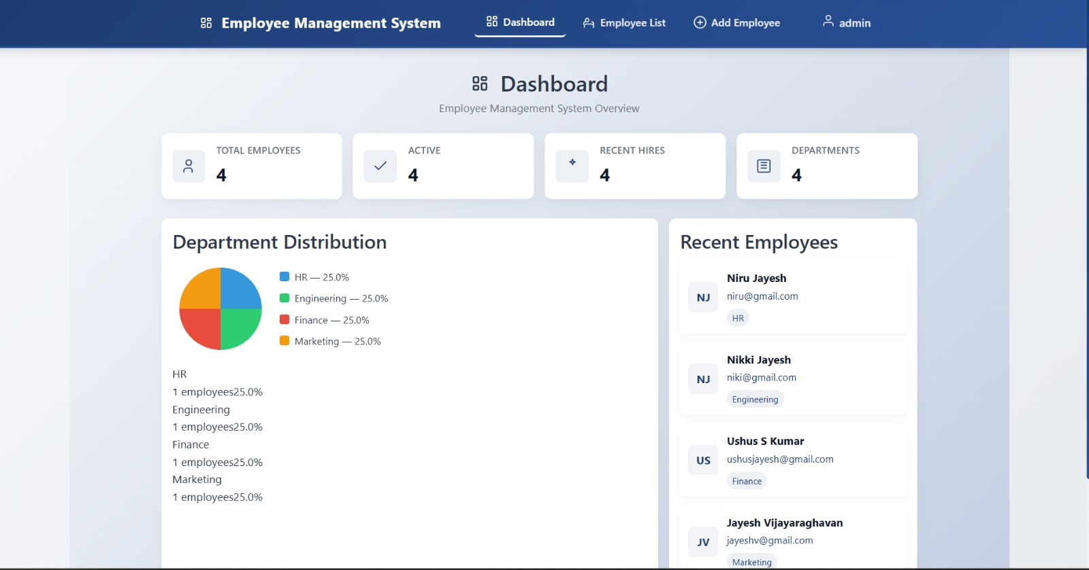
Employee Management System Application ScreenShots
Employee Details form
Dashboard

Slide 14
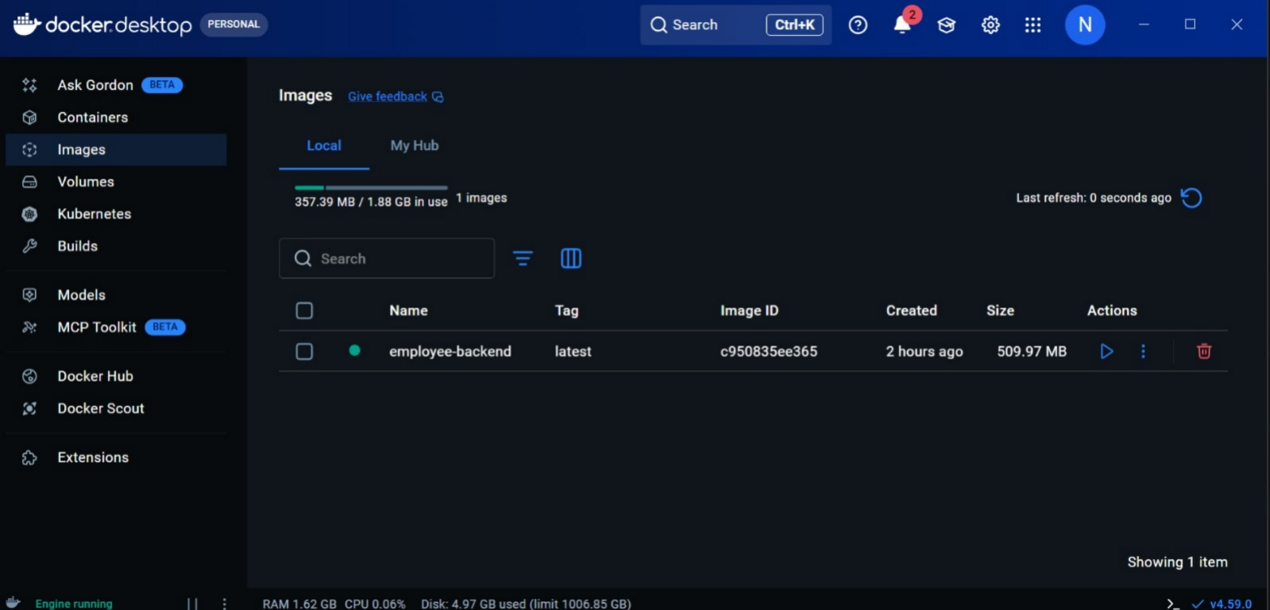
Employee Management System
Docker Deployment

Slide 15
Employee Management System
Conclusion
Employee Management System is a full‑stack web application that helps administrators to manage employee records, roles, and related workflows efficiently.
It provides:
-- Centralized employee CRUD (create, read, update, delete) and profile management
-- Role-based access control and secure authentication (JWT) for admins and users
-- RESTful API with validation, search, filtering, and pagination for fast data access
-- Audit-ready activity logging and data integrity with MySQL persistence
-- Docker services for consistent environments and easy deployment (backend + database)
-- Ready for cloud deployment and scaling (can be deployed to Azure or other cloud providers)
At last, this Capstone project demonstrates the practical implementation of modern web technologies - Angular, Spring Boot, MySQL, and Docker to solve real‑world employee management challenges, improving operational efficiency, maintainability, and deployment portability.

